Slide 1

LEVEL DESIGN DOCUMENT
LEVEL DESIGN DOCUMENT
LEVEL DESIGN DOCUMENT
Manifold
PFA
Team Feurtone

Slide 2
General Information
General Information
General Informarion
SHOP
AREA
RESTAURANT
AREA
GENERAL INFORMATIONS
-Early game mission
-Show all core mechanics and movements
-2 fight room + boss
2D STREET
BOSS
ROOM
Manifold
PFA
Team Feurtone

Slide 3
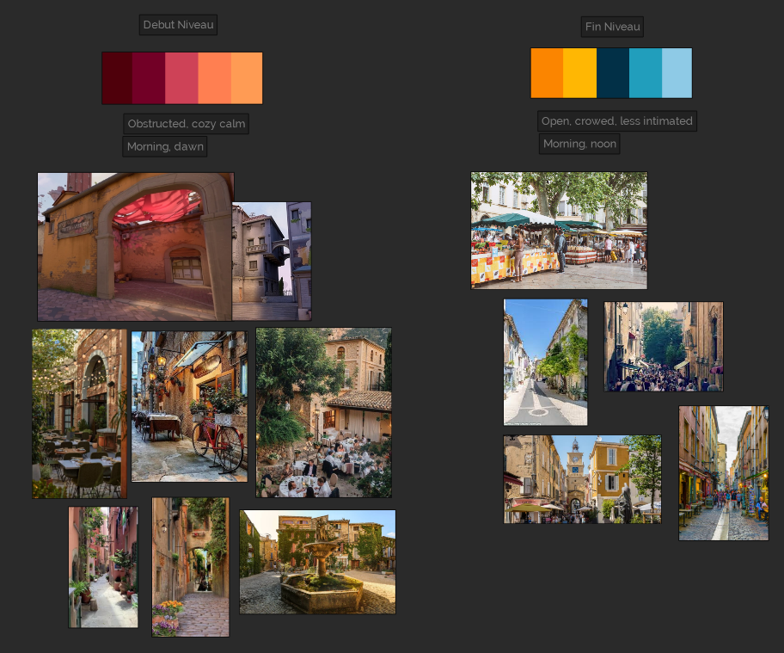
Moodboard
Moodboard
Moodboard
From a cozy and narrow place to an open and less intimate space
Warm color to cold color
Inspiration from Provence, little town
Small terrace
Restaurant, small shops
Manifold
PFA
Team Feurtone

Slide 4
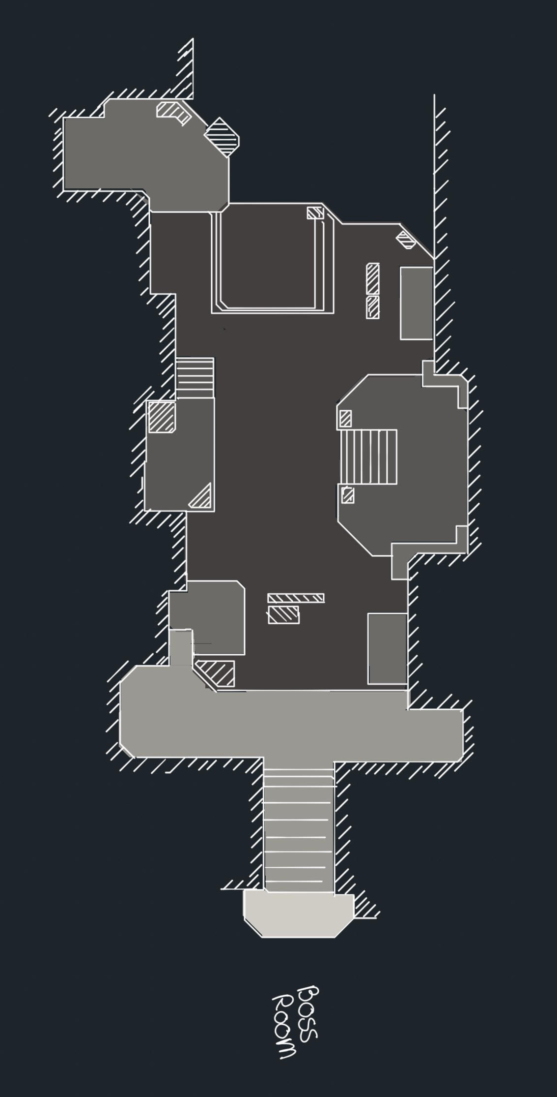
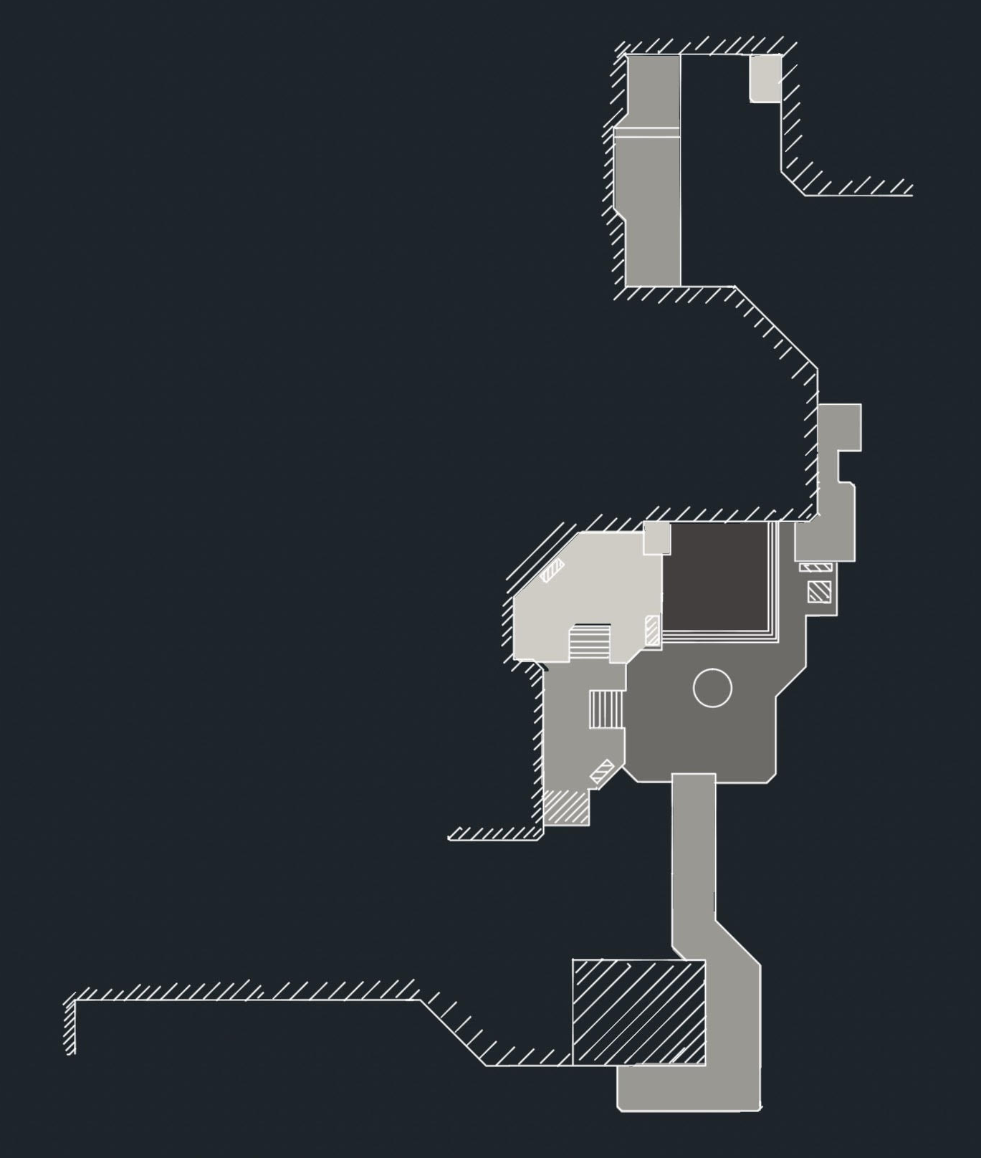
LEVEL
LEVEL
LEVEL
Part 2
Part 1
Level elements:
- 2D Wall
- Pushable block
- Fight room
- Collectable
Manifold
PFA
Team Feurtone

Slide 5
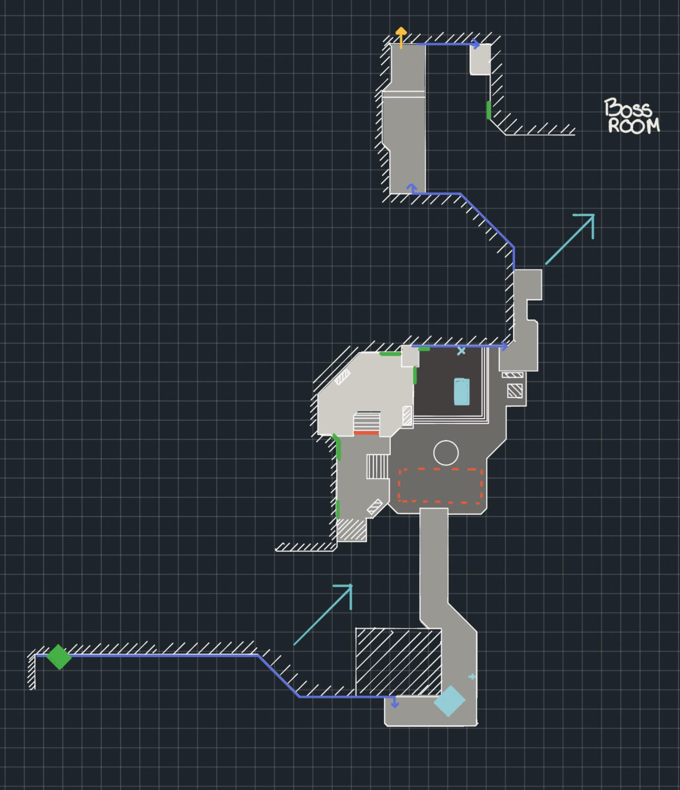
PART 1
PART 1
PART 1
5D Power
2D Wall
Push Block
Fight room trigger
Fight wall
Ivy wall
Exit
Vista
Collectable
Manifold
PFA
Team Feurtone

Slide 6
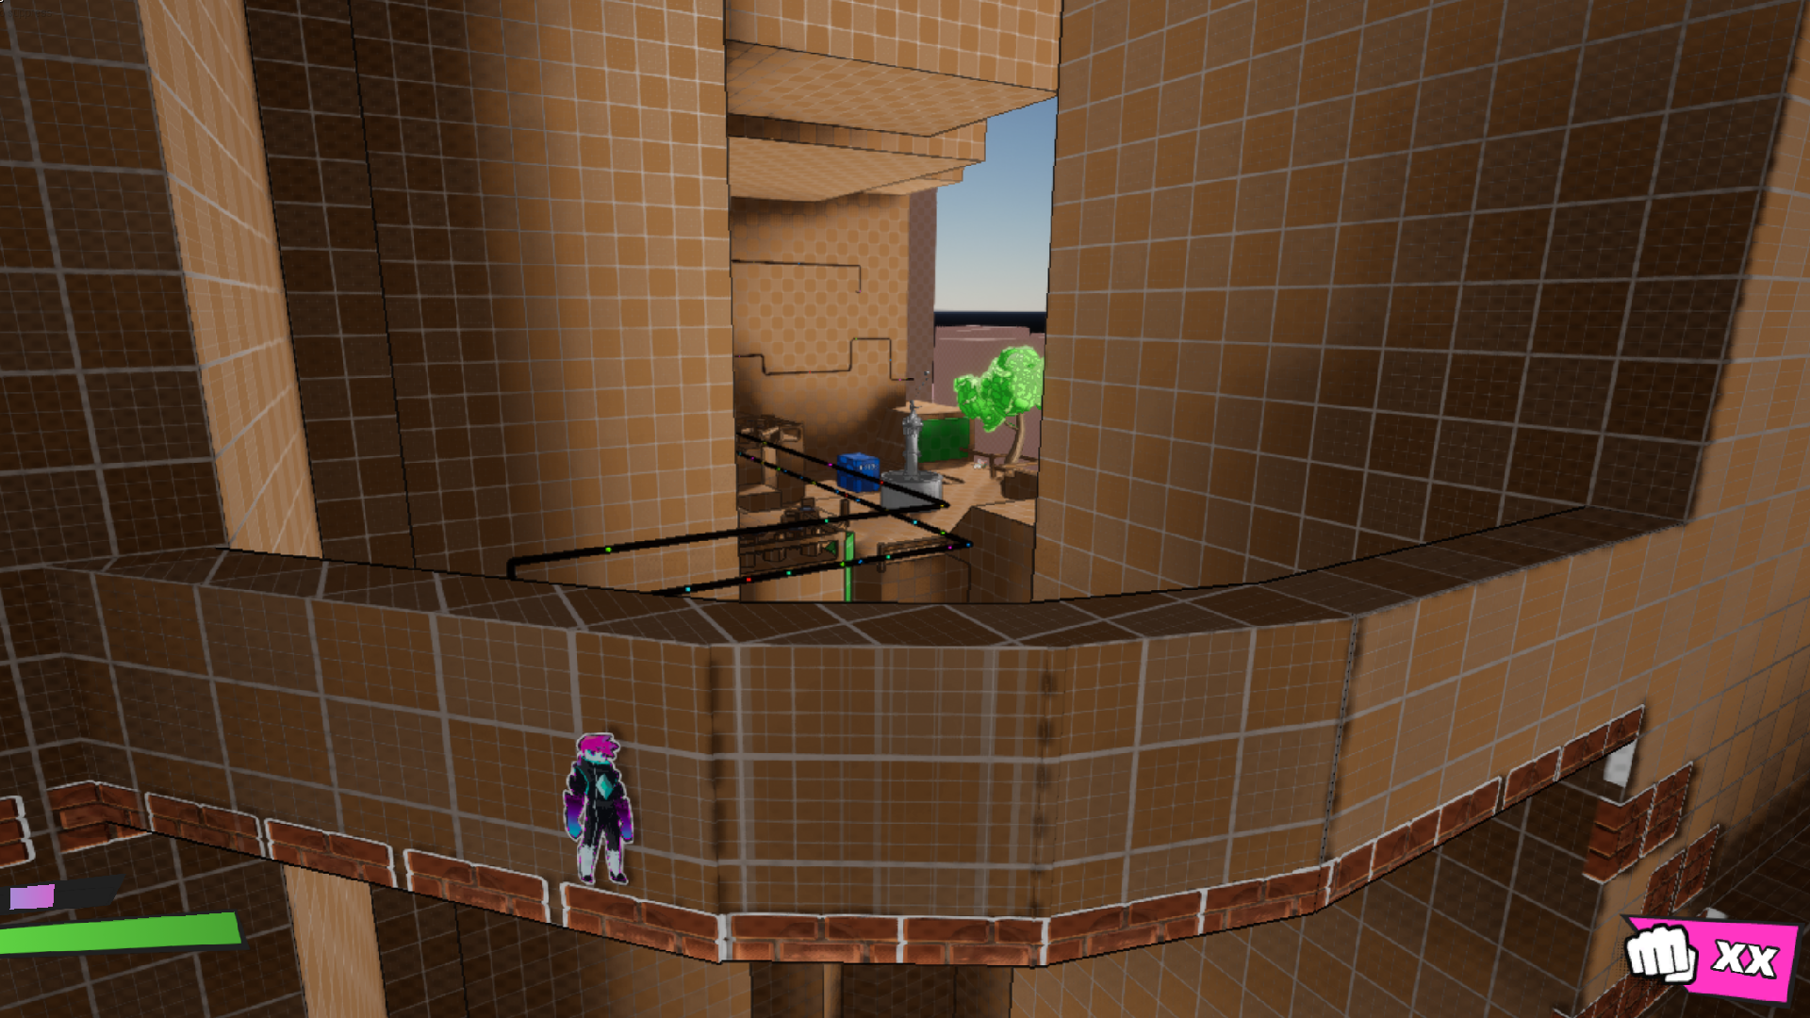
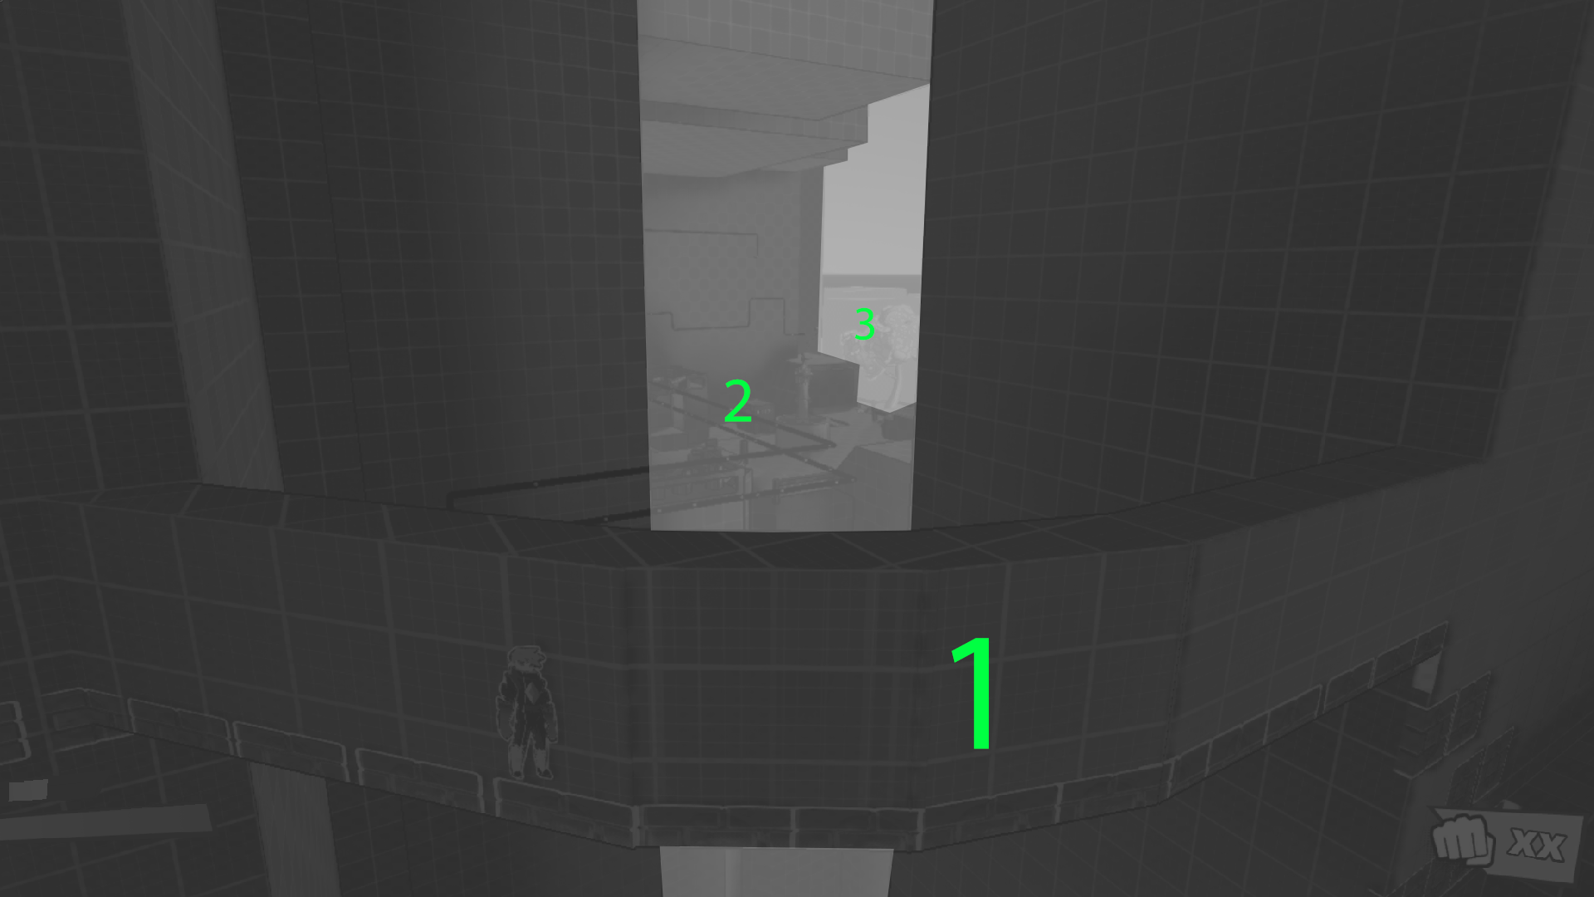
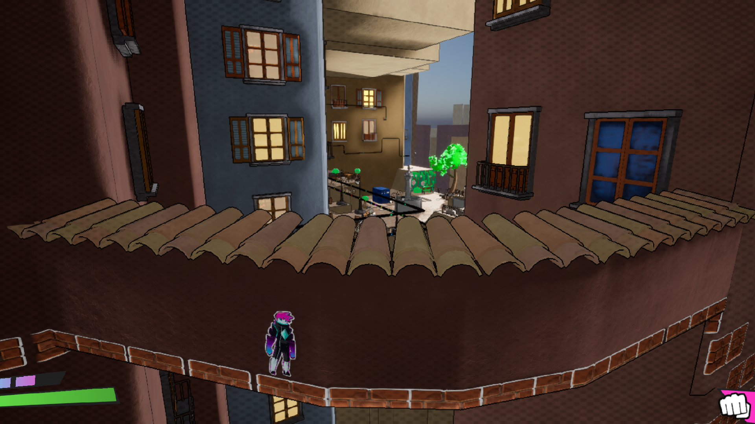
PART 1
PART 1
PART 1
Blockout
Current/Middle/Long term objective
Level Art
Manifold
PFA
Team Feurtone

Slide 7
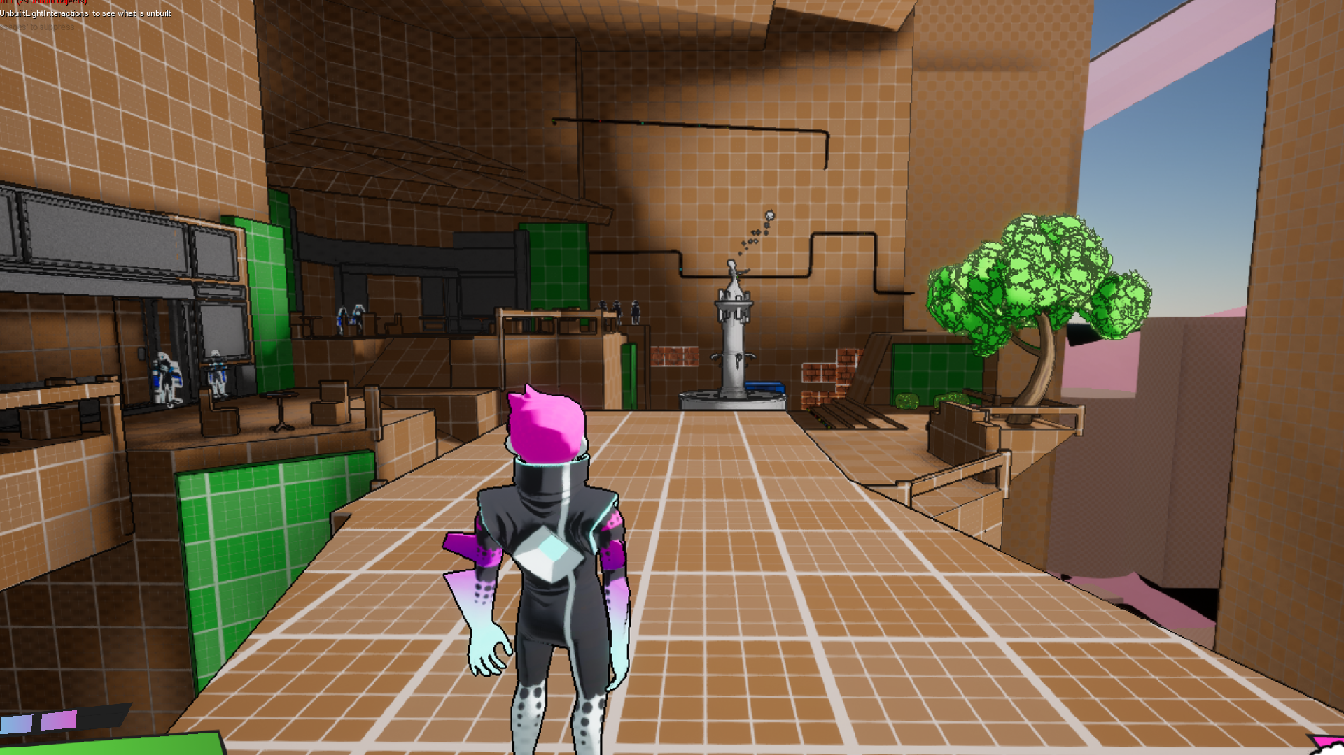
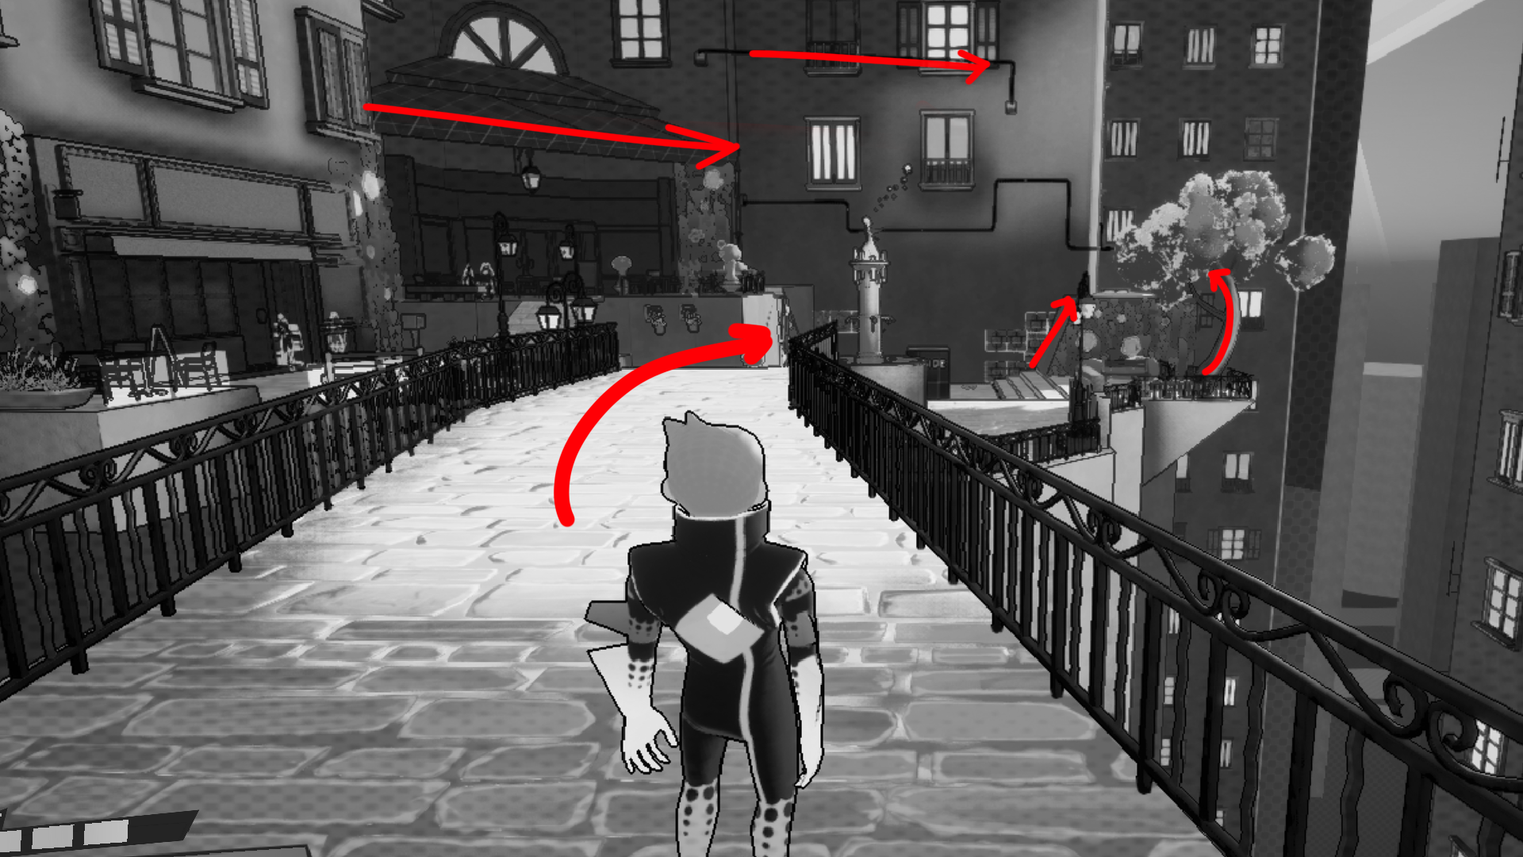
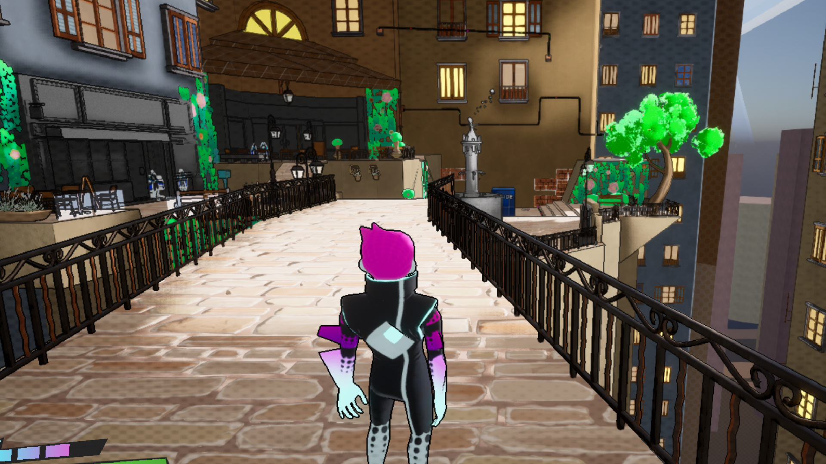
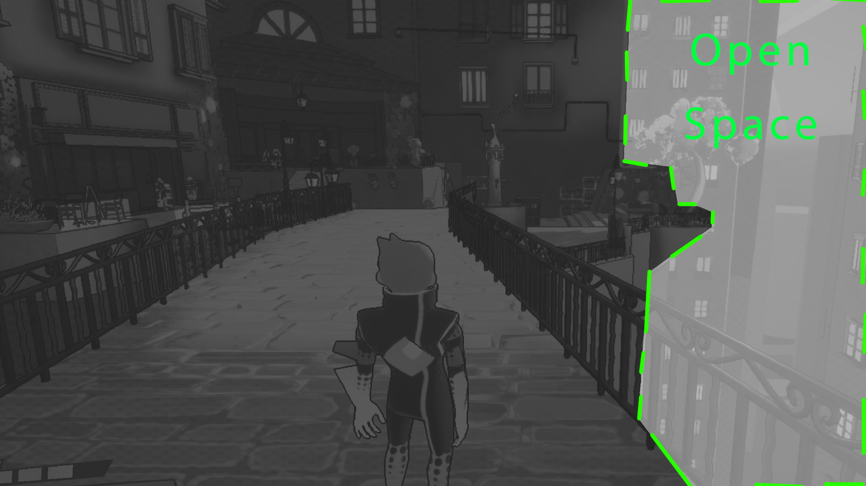
PART 1
PART 1
PART 1
Blockout
Direction line
Level Art
Difference indoor/Open spance
Manifold
PFA
Team Feurtone

Slide 8
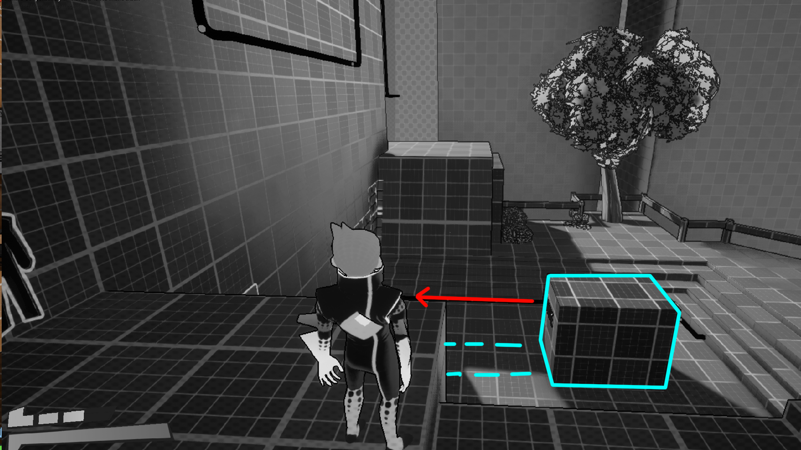
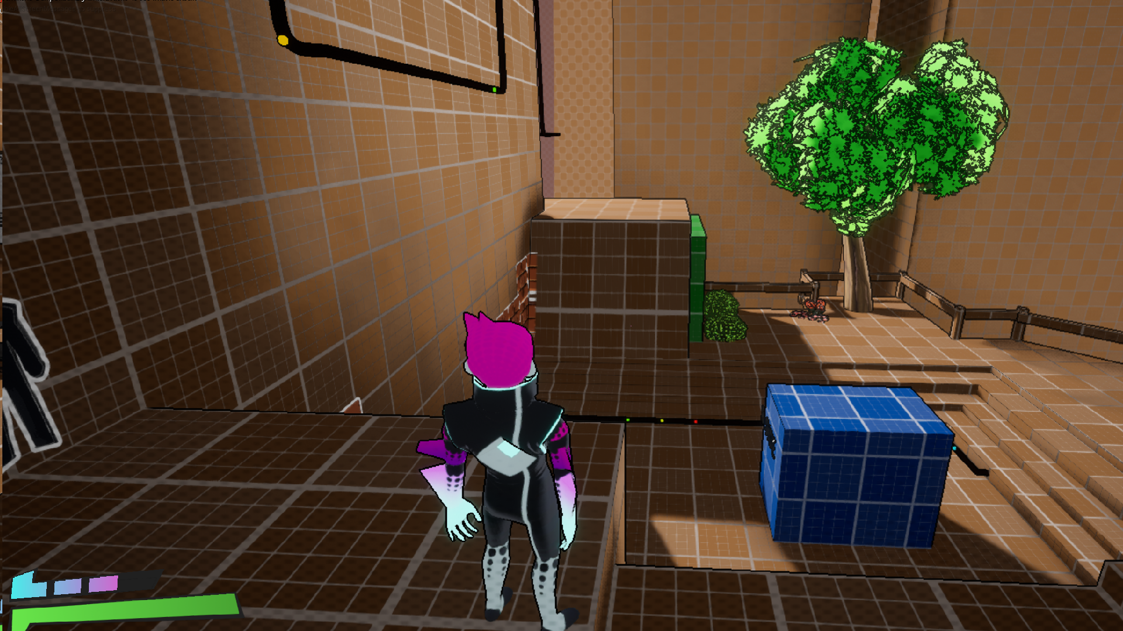
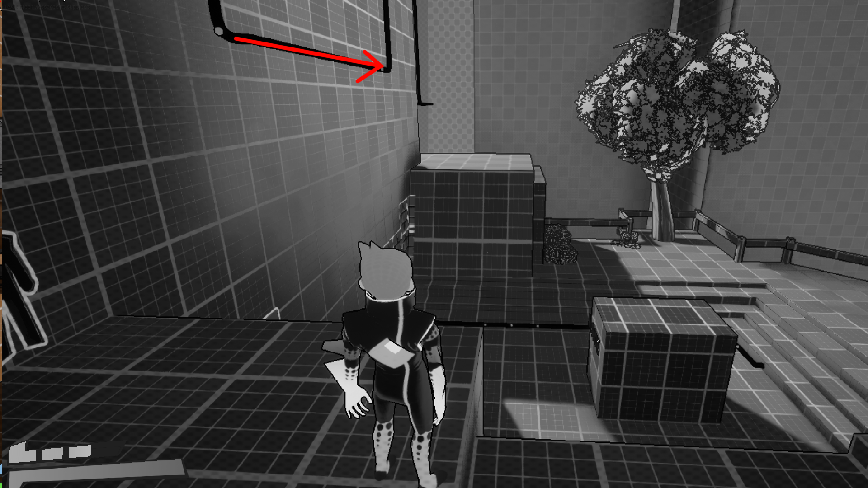
PART 1
PART 1
PART 1
Pushable Block
Blockout
Affordance Item (wheel + trace on ground) + Yellow color
1D line show Path
Manifold
PFA
Team Feurtone

Slide 9
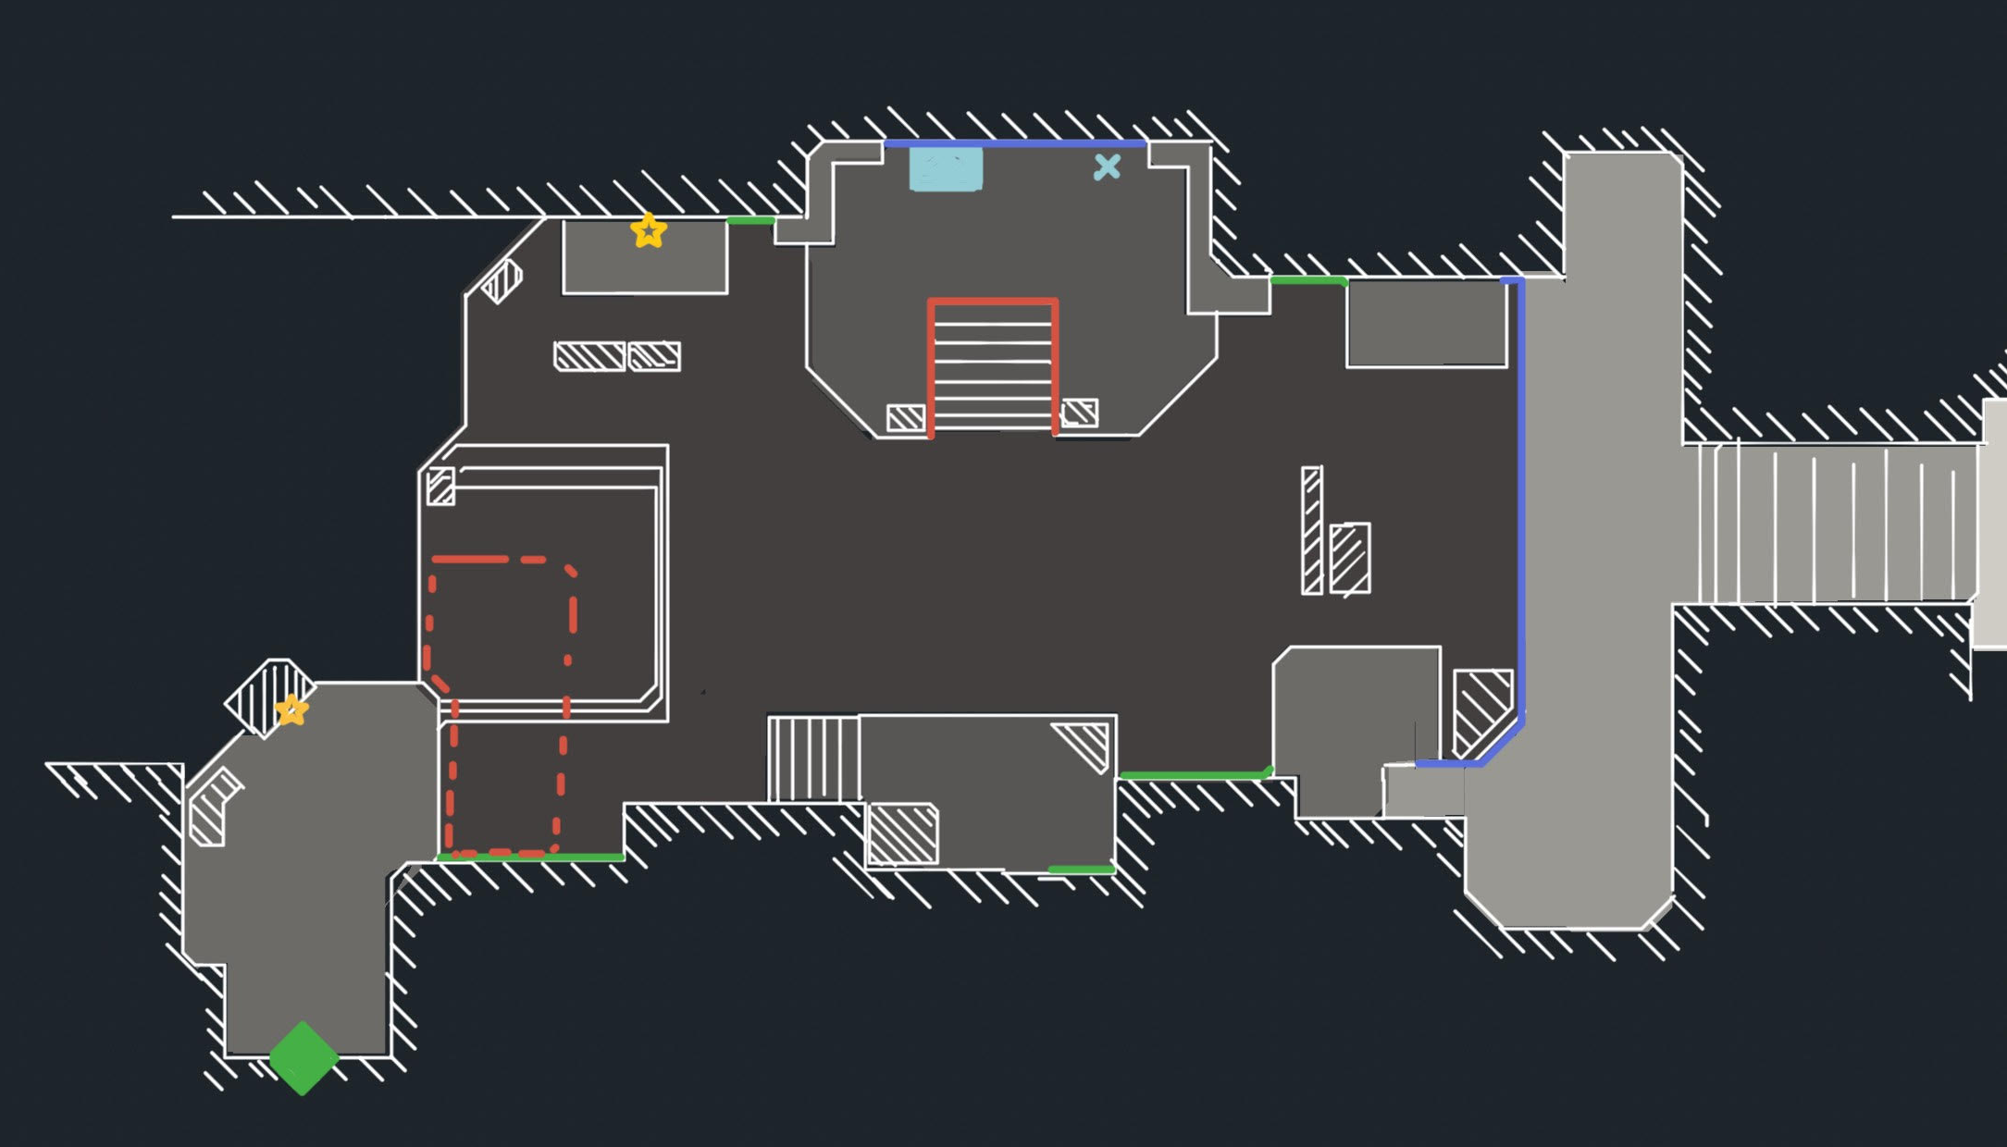
PART 2
PART 2
PART 2
5D Power
2D Wall
Push Block
Fight room trigger
Fight wall
Ivy wall
Exit
Vista
Collectable
Manifold
PFA
Team Feurtone

Slide 10
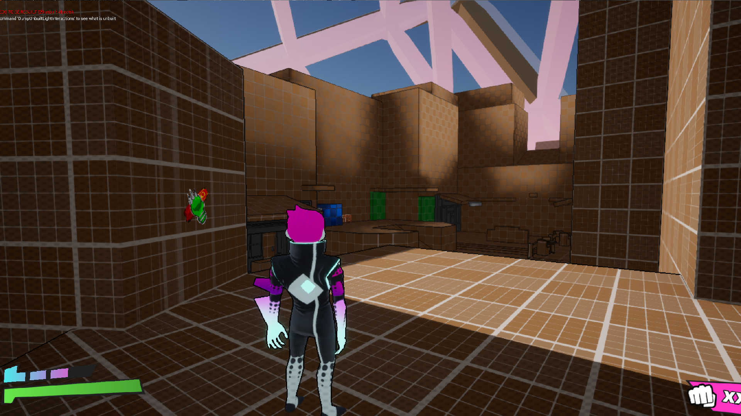
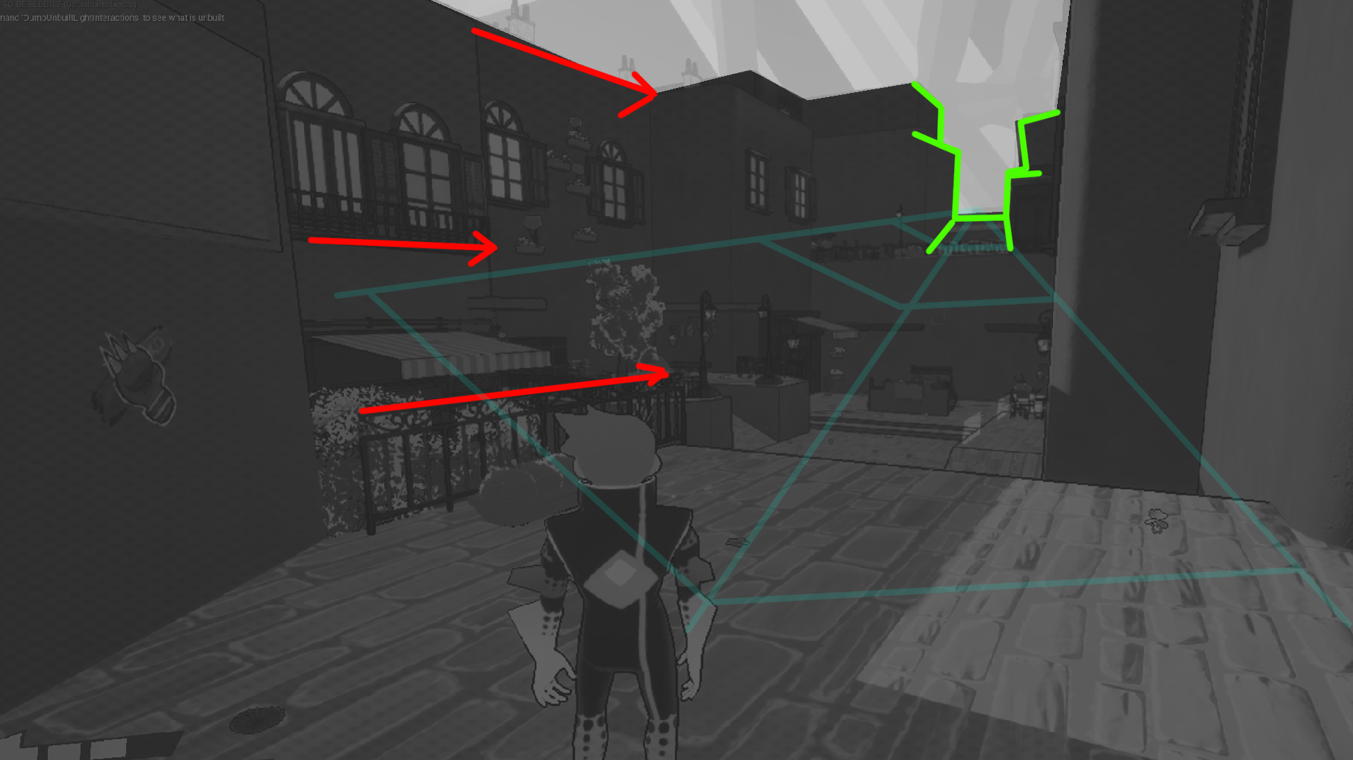
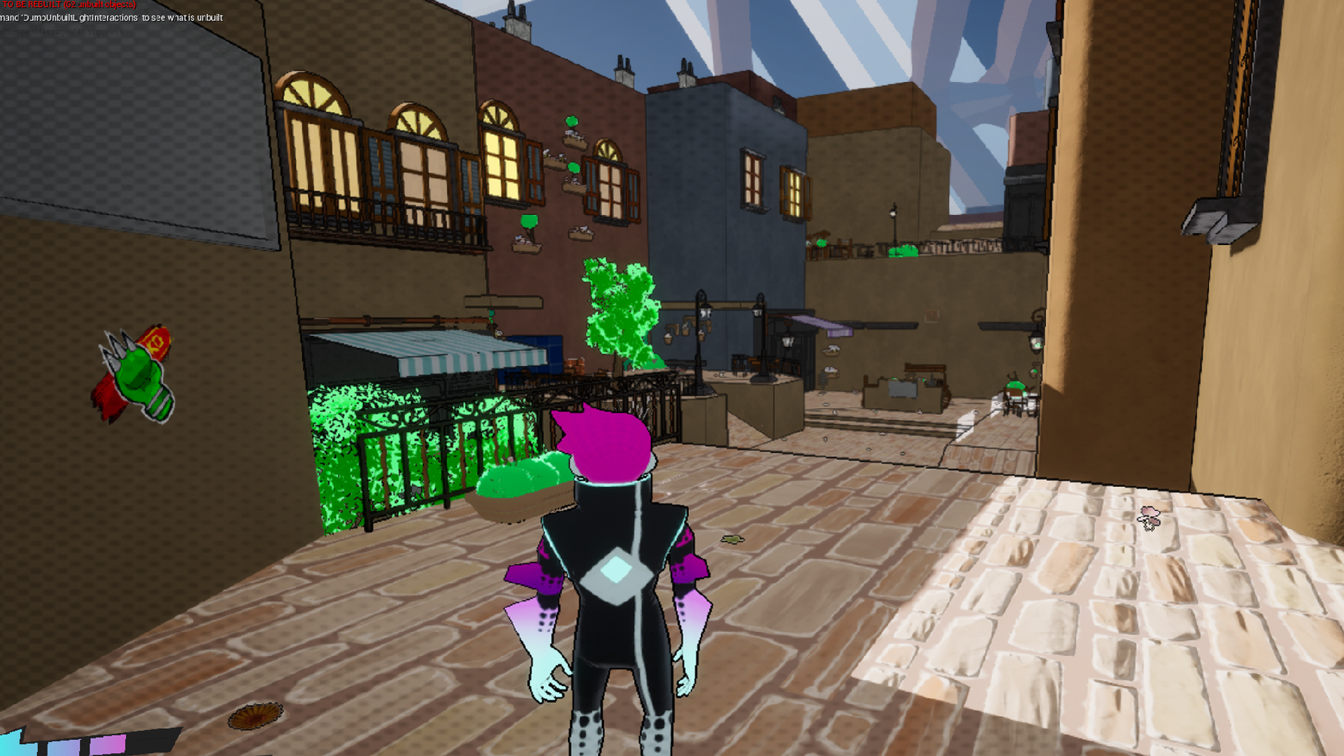
PART 2
PART 2
PART 2
Blockout
Guide line + Open area contrast
LA
Manifold
PFA
Team Feurtone

Slide 11
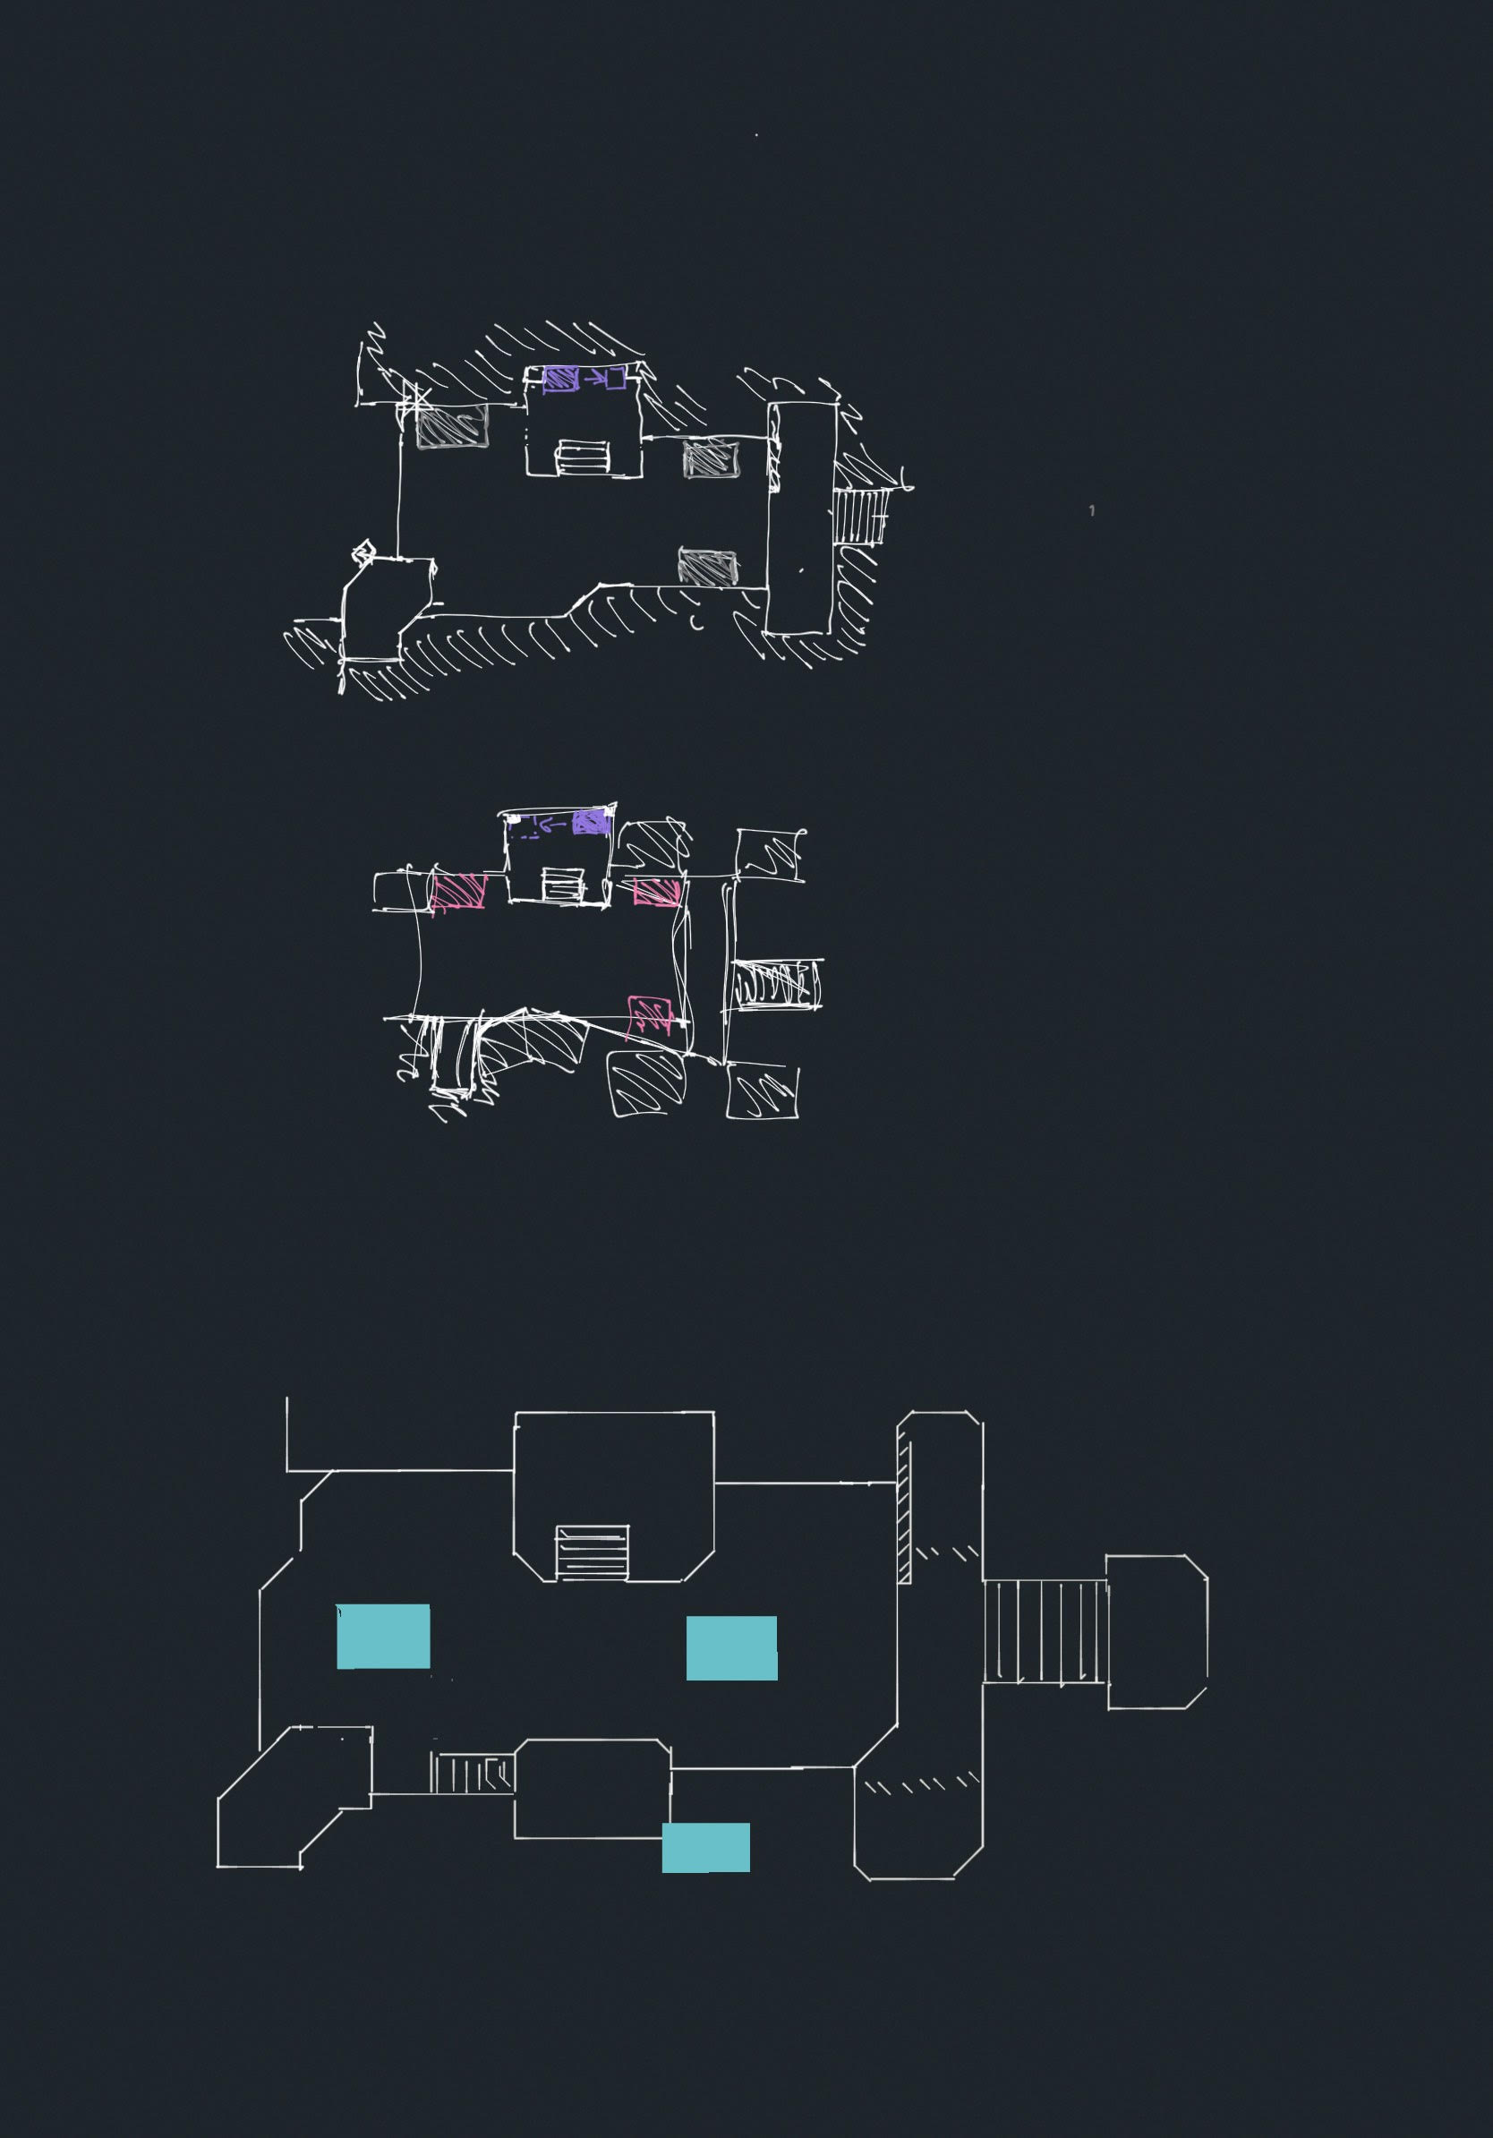
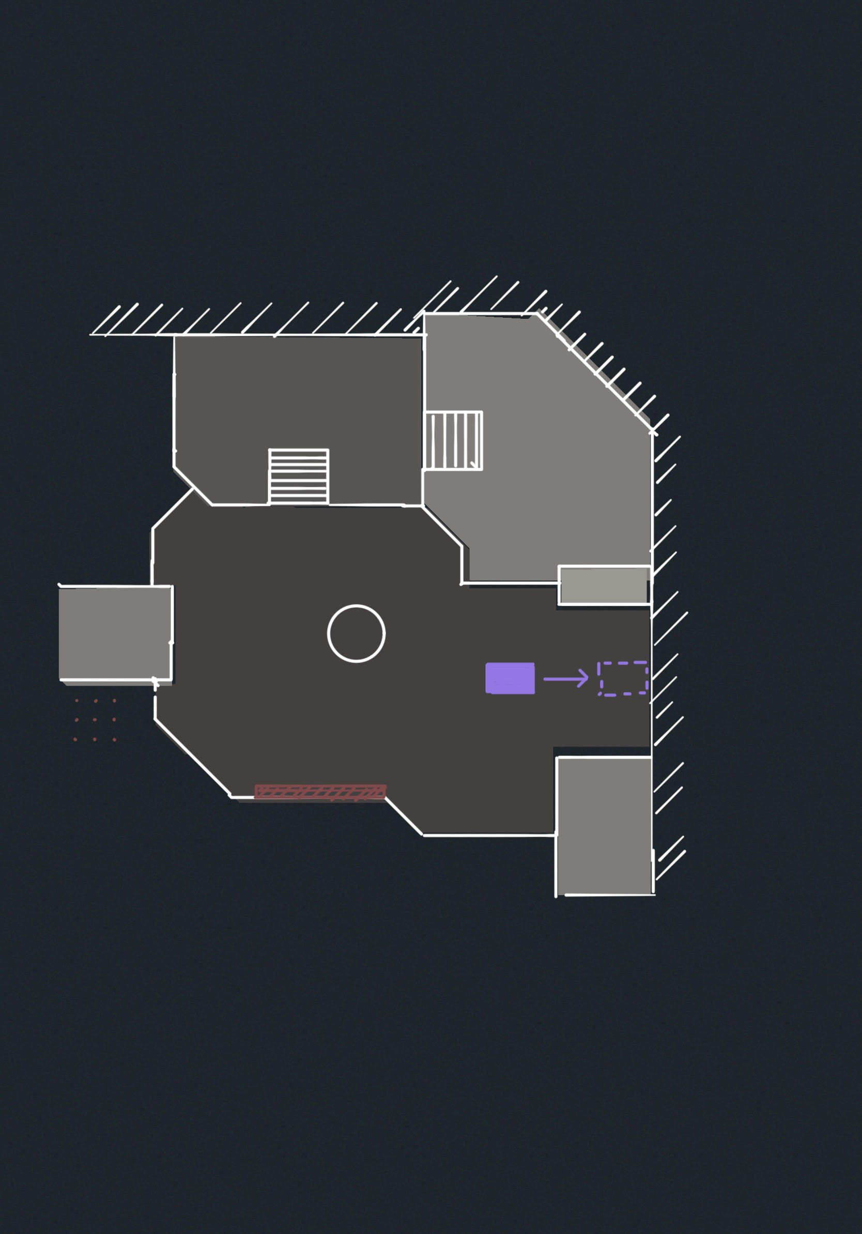
Draft
Draft
Draft
Part 2 Sketch
Part 1 Sketch
Manifold
PFA
Team Feurtone

